Slide 1
Modern Art Generator
Aiden Chiavatti
Corey Zalewski

Slide 2
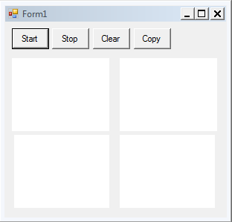
Overview
Multiple threads drawing several images concurrently
Draws random shapes/colors
Allows user to specify and load in “themes” to dictate drawing style

Slide 3
Features
Multiple canvases to draw on
Threads will randomly generate shapes
Shapes will be of random color, size, and thickness
User can stop and start the drawing process
User can clear canvases to restart an image
User can copy an image from one canvas to the others
User can select a theme/behavior for thread drawing

Slide 4
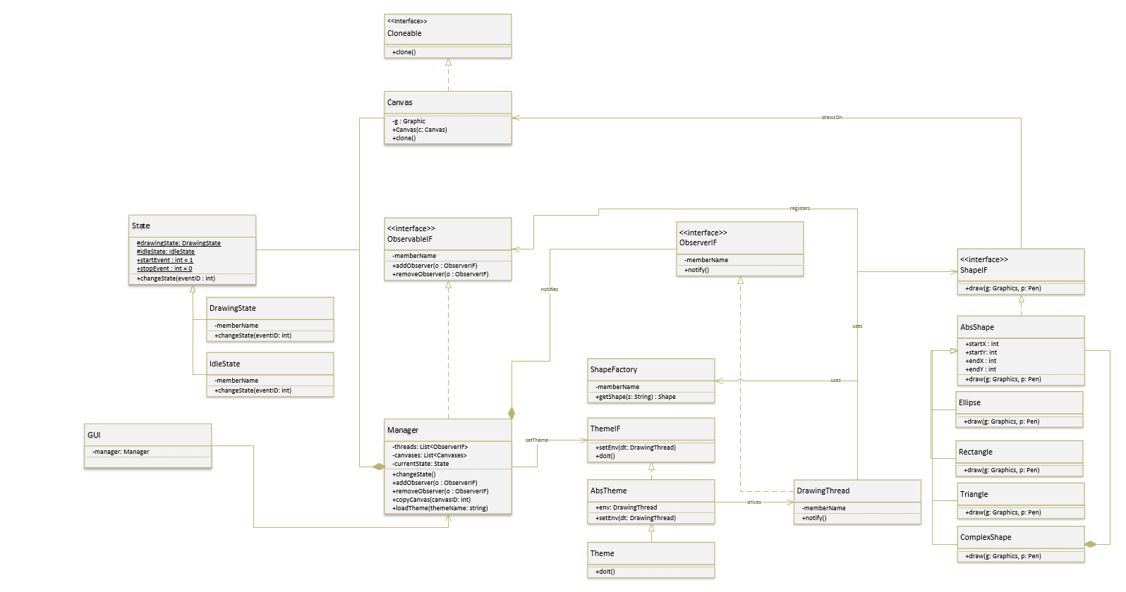

Slide 5
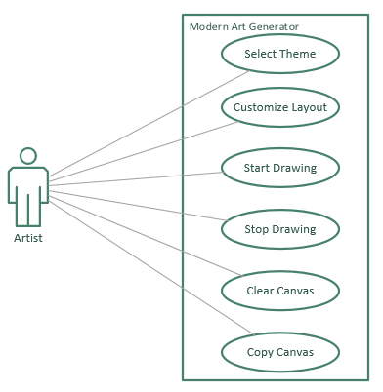
UML Use Case Diagram

Slide 6
Patterns Used
Factory Method
Allows threads to load in shape objects
Prototype
Takes a canvas and copies it to create new canvases of the same image
Composite
Creates new shapes composed of other shapes

Slide 7
Patterns Used
Dynamic Linkage
Allows users to load in new programs for drawing behavior
State
Threads will have two states: drawing and not drawing so that the user cannot make changes while a thread is in progress
Observer
All threads will be notified together of state changes (when to start/stop drawing)
Two-Phase Termination
Threads will have two terminating phases: interrupt and shutdown. In the interrupt phases, threads will be interrupted by the notify, and then will move to the shutdown phase. This will ensure that a thread finishes drawing, terminates, and releases the necessary resources.

